Slide 1


Why Didn’t You
Listen to Me?
Humans’ Perceptions and Experience when Controlling Transparent Models
HCIL Workshop on Human-Centered AI
May 28, 2020
Alison Smith-Renner
alison.renner@wbbinc.com

Slide 2
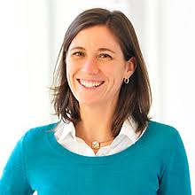
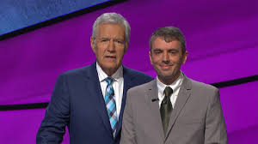

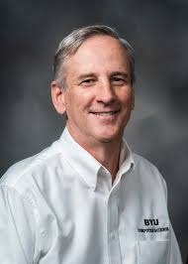



Leah Findlater
Jordan Boyd-Graber
Kevin Seppi
Varun Kumar

Slide 3



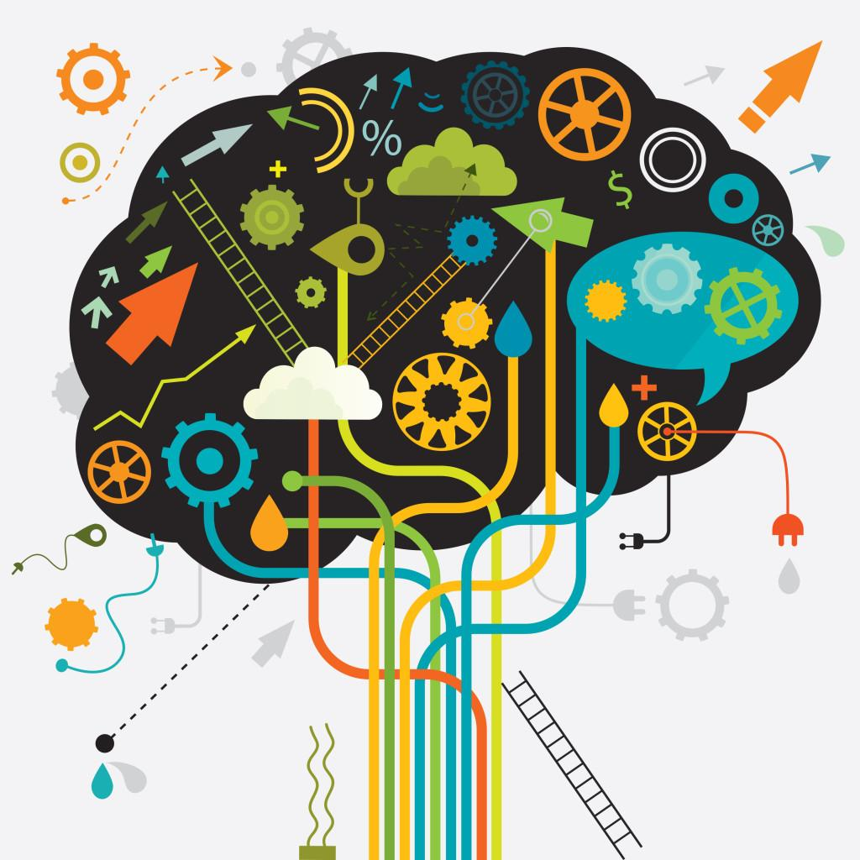


End Users + Machine Learning
accurate?
biased?
accept?
ignore?
improve
adapt

Slide 4
Interactive Machine Learning
human-in-the-loop

Slide 5

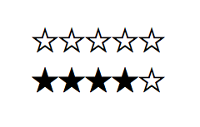

Control in Interactive Machine Learning
Control: Whether/how humans influence systems
CONTROL
NO CONTROL

Slide 6

Shared Control in Interactive Machine Learning
USER INPUTS
MODELED DATA
Adherence - whether models incorporate user input as specified
Instability - whether models make other changes

Slide 7
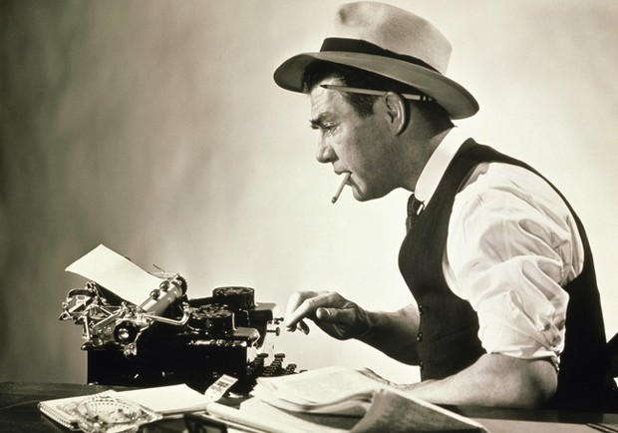

Interactive Machine Learning for
Too Much Text Data

Slide 8
Topic Modeling
After weeks of speculation, anticipation and a dose of hype, Apple is widely expected to announce a new smartphone at an event in San Francisco on Wednesday. Apple isn't saying anything about the topic of the event, but the email invitation it sent to reporters contains a shadow in the shape of a "5'' - a nod to the iPhone 5.
Phil Schiller, Apple's marketing chief, took the stage in San Francisco and unveiled the iPhone 5. Naturally, the Apple exec touted how beautiful the device is but upgrades will largely be driven by price.
San Francisco Giants' Brandon Belt, right, is congratulated by third base coach Roberto Kelly (39) as he rounds the bases after hitting a solo home run during the second inning of a baseball game against the Cincinnati Reds, in Cincinnati.
unit block of College Avenue, 3:30 a.m. May 4. A St. John's College campus police officer saw a man standing near a vehicle in a parking lot. When the officer approached, the man ran off. The contents of the unlocked vehicle was rummaged through but it's unknown if anything was stolen.
{Apple, iphone, device, price, smartphone, …}
{officer, stolen, vehicle, man, crime, …}
{announce, unveiled, topic, saying, …}
{baseball, base, home, coach, game, run, …}
{San, Cincinnati, Francisco, near, block, …}

Slide 9
Topic Modeling
After weeks of speculation, anticipation and a dose of hype, Apple is widely expected to announce a new smartphone at an event in San Francisco on Wednesday. Apple isn't saying anything about the topic of the event, but the email invitation it sent to reporters contains a shadow in the shape of a "5'' - a nod to the iPhone 5.
Phil Schiller, Apple's marketing chief, took the stage in San Francisco and unveiled the iPhone 5. Naturally, the Apple exec touted how beautiful the device is but upgrades will largely be driven by price.
San Francisco Giants' Brandon Belt, right, is congratulated by third base coach Roberto Kelly (39) as he rounds the bases after hitting a solo home run during the second inning of a baseball game against the Cincinnati Reds, in Cincinnati.
unit block of College Avenue, 3:30 a.m. May 4. A St. John's College campus police officer saw a man standing near a vehicle in a parking lot. When the officer approached, the man ran off. The contents of the unlocked vehicle was rummaged through but it's unknown if anything was stolen.
{Apple, iphone, device, price, smartphone, …}
{officer, stolen, vehicle, man, crime, …}
{announce, unveiled, topic, saying, …}
{baseball, base, home, coach, game, run, …}
{San, Cincinnati, Francisco, near, block, …}

Slide 10

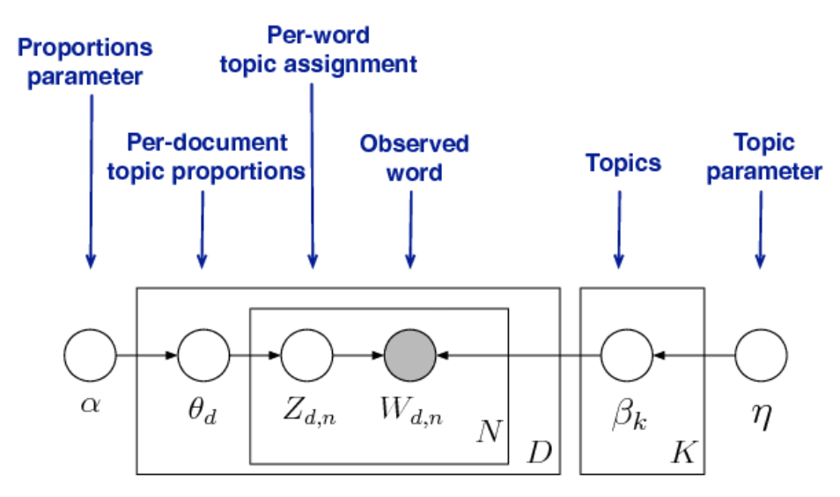

Topic Modeling for Algorithm Experts and Non Experts
How to improve low quality models?
?
?
?

Slide 11
Interactive Topic Modeling
Non-expert users iteratively refine model during generation (e.g., adding words, removing topics)
{San, Cincinnati, Francisco, near, block, …}
{Cincinnati, San Francisco, near, block, …}
{baseball, base, home, coach, game, run, inning, out, …}
{base, home, baseball, coach, game, run, …}

Slide 12
Unpredictable Updates in Interactive Topic Modeling
changes not always incorporated as specified (adherence)
small changes to the topic model can propagate in unexpected ways (instability)
{Cincinnati, San Francisco, near, block, …}
{California, San Francisco, near, block, …}
{baseball, base, home, coach, game, run, inning, out, …}
{inning, baseball, base, home, game, run, out, strike, ...}

Slide 13
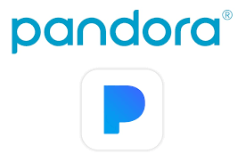
Easy vs. Difficult to Validate Controls
easy-to-validate controls
difficult-to-validate controls
{Cincinnati, San Francisco, near, block, …}
{baseball, base, home, coach, game, run, inning, out, …}
users want controls, regardless of whether they “work” (Vaccaro et al. 2018)
K. Vaccaro, D. Huang, M. Eslami, C. Sandvig, K. Hamilton, and K. Karahalios. The Illusion of Control: Placebo Effects in Control Settings. CHI (2018)

Slide 14
Desired Refinements
add word to topic
remove word from topic
change word order in a topic
remove document from topic
split topic
merge topics
add word to stop words (ignore from modeling)
Add words...
Split topics..
Lee, T. Y., Smith, A., Seppi, K., Elmqvist, N., Boyd-Graber, J., & Findlater, L. (2017). The human touch: How non-expert users perceive, interpret, and fix topic models. International Journal of Human-Computer Studies, 105, 28-42.

Slide 15
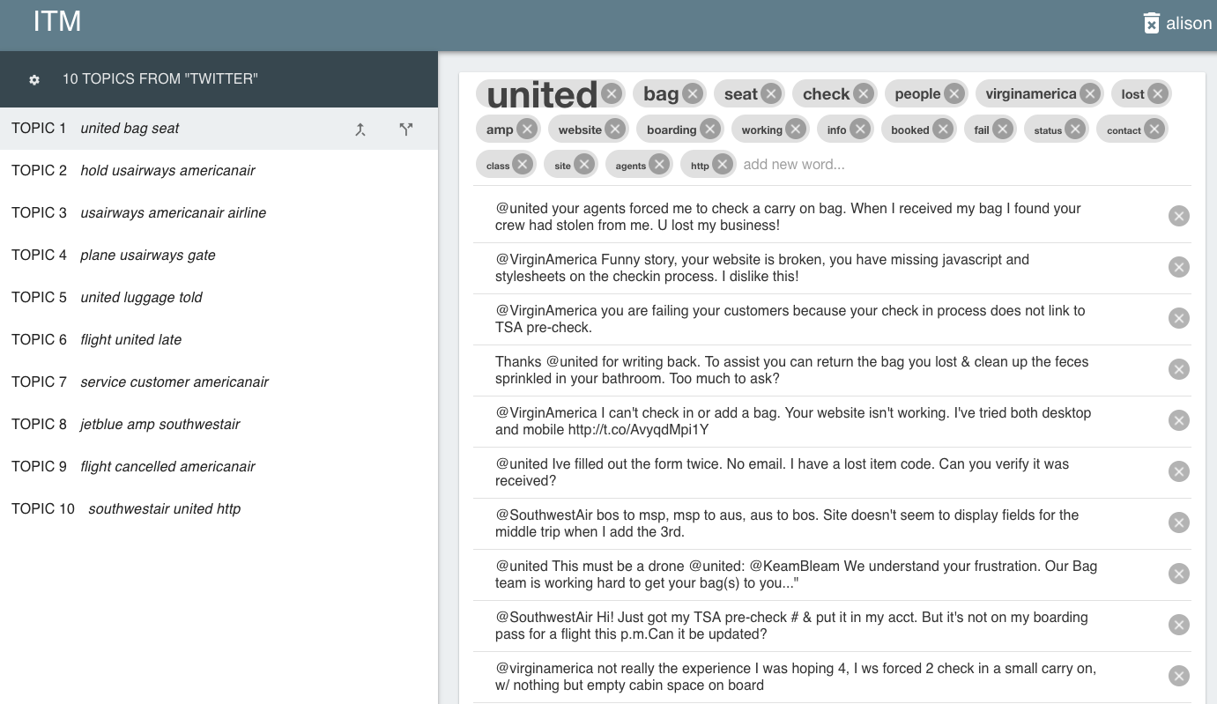
ITM INTERFACE

Slide 16
Study I: Exploratory, Think Aloud
Dataset: tweets complaining about air travel
Task: organize the tweets into different categories of complaints (e.g., lost luggage)
Think aloud and 20 minutes to perform task
Rated agreement with statements about adherence and instability
Smith, A., Kumar, V., Boyd-Graber, J., Seppi, K., & Findlater, L. (2018, March). Closing the loop: User-centered design and evaluation of a human-in-the-loop topic modeling system. In 23rd International Conference on Intelligent User Interfaces (pp. 293-304).

Slide 17
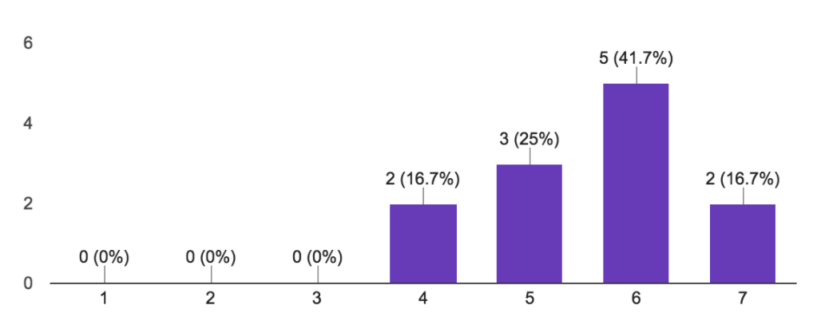
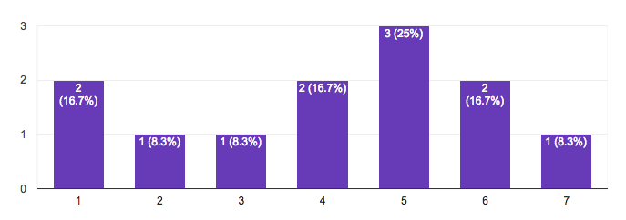
Q: Do users perceive a lack of adherence or instability?
ADHERENCE
STABILITY
“The refinements I made were applied as expected when I clicked update”
“No changes other than the refinements I made occured when I clicked update”
DISAGREE
AGREE
DISAGREE
AGREE

Slide 18
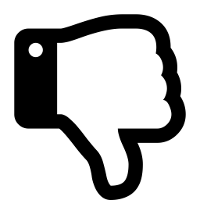

Q: How are users affected by unpredictable controls?
LACK OF ADHERENCE
ADHERENCE
INSTABILITY
(after moving Southwest to the end of the list) “let me see what happens when I save...oh great, Southwest is back [at the front of the list].”
(after adding a word that was put in front of the list) “I don’t think it should always give [my added word] importance, because I could be wrong.”
“I’m noticing a few extra words came up, I don’t know how.”
“New words were added on to the list to replace the ones removed. It made the model better.”
“...but I remembered being happy with the topic and when that changed it made me unhappy.”

Slide 19
Study I: Summary
perceived adherence, mixed on instability
polarized by unpredictability in general
Study II: comparing modeling approaches...
Smith-Renner, A., Kumar, V., Boyd-Graber, J., Seppi, K., & Findlater, L. (2020, March). Digging into user control: perceptions of adherence and instability in transparent models. In Proceedings of the 25th International Conference on Intelligent User Interfaces.

Slide 20
Study II: Comparing Modeling Approaches
info-gibbs
2. info-vb
3. cons-gibbs
user input:
INFORMED PRIORS
INFORMED PRIORS
CONSTRAINTS
inference:
GIBBS SAMPLING
VARIATIONAL INFERENCE
GIBBS SAMPLING
faster
+ stability
+ adherence
+ adherence
*all implementations are slow (average 15-20 seconds per refinement)
Kumar, Varun, Smith-Renner, Alison, Findlater, Leah, Seppi, Kevin, Boyd-Graber, Jordan. “Why Didn’t you Listen to Me? Comparing User Control of Human-in-the-Loop Topic Models. Proceedings of the Association of Computational Linguistics. 2019.
Yang, Yi, Doug Downey, and Jordan Boyd-Graber. "Efficient methods for incorporating knowledge into topic models." Proceedings of the 2015 Conference on Empirical Methods in Natural Language Processing. 2015.

Slide 21

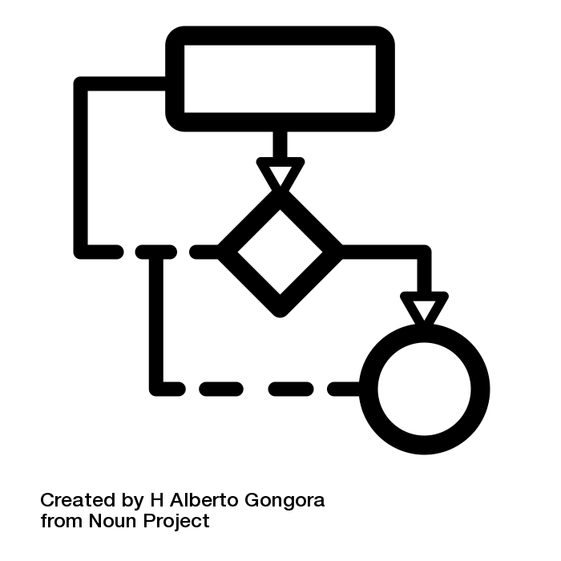
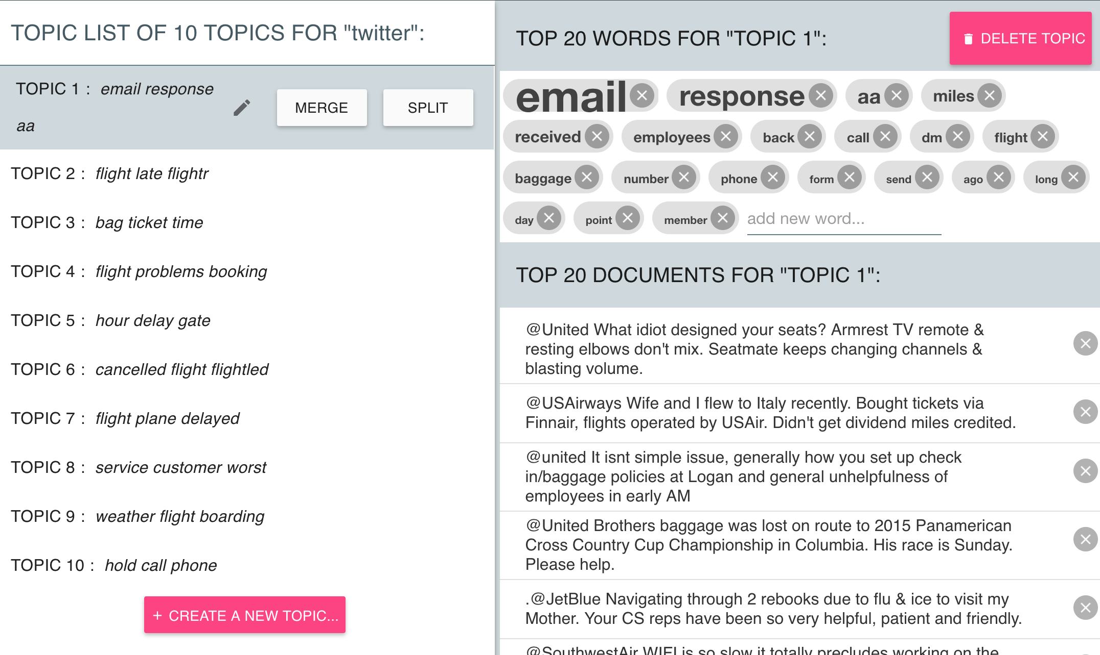

Study II
X 100
1
2
3
info-gibbs
info-vb
const-gibbs
Frustrating? Adherence? Instability? ...

Slide 22
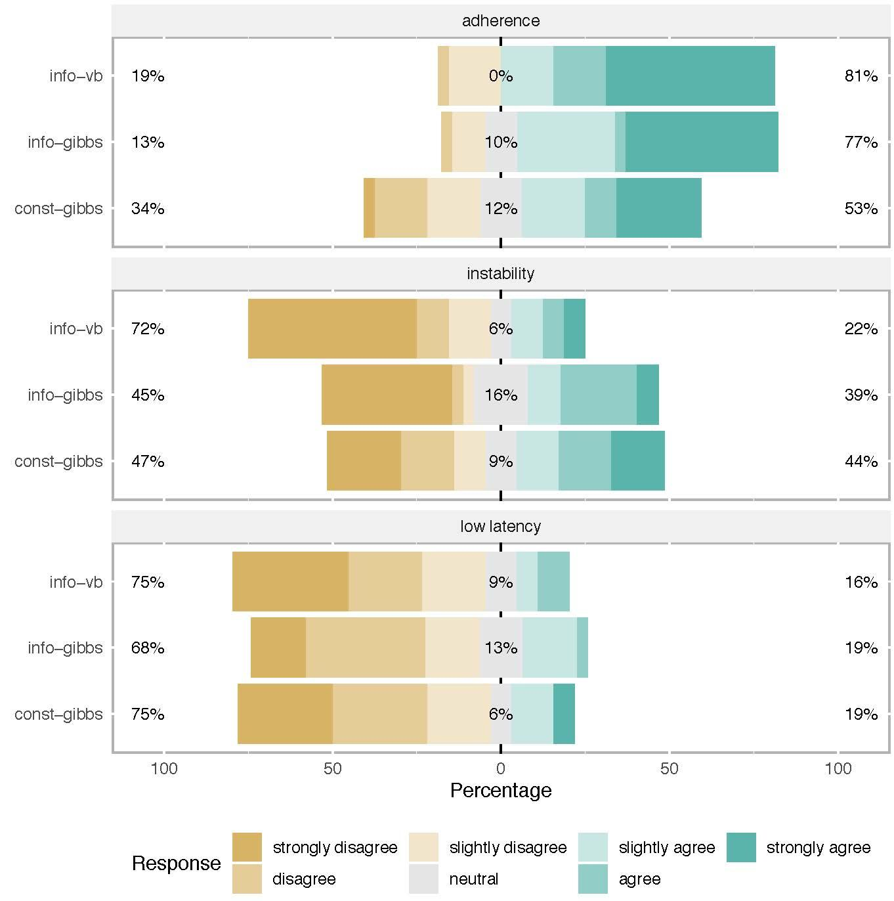
Q: Did users perceive lack of adherence?
“The tool made the changes I asked it to make”
least adherent
system adhered to input

Slide 23
Q: How were users affected by lack of adherence?
Unlike “difficult-to-validate” findings (Vaccaro et al. 2018)
Second most disliked (22%) and most unexpected (36%) of the characteristics
Refinements that did not work as expected (e.g., change word order and add word) were less popular than those that did (e.g., merge topics)
→ adherence is important when controls are easy-to-validate
K. Vaccaro, D. Huang, M. Eslami, C. Sandvig, K. Hamilton, and K. Karahalios. The Illusion of Control: Placebo Effects in Control Settings. CHI (2018)

Slide 24
Q: Did users perceive instability?
“The tool made other changes beyond what I asked it to make”
most stable
system was stable
“I didn’t expect the word list to automatically update after adding a new word, but I thought that was cool”
“I removed [a word] and saw it in a later topic… bad ML!”
→ users might be willing to share control with a helpful partner

Slide 25
Study II: Summary
Participants disliked slow updates the most, followed by lack of adherence
Instability was polarizing
Across modeling approaches, participants differed only in whether they noticed adherence

Slide 26
Designing for the Human in the Loop
How do users expect systems to adhere to their input and how to manage expectations?
Users want to be heard, but may be willing to share control with a good machine teammate
  Users want controls (Kolcielnik et al. 2019, Vaccaro et al. 2018)
  ML systems balance user inputs and data
  Unpredictable control was polarizing
R. Kocielnik, S. Amershi, and P.N. Bennet. Will You Accept an Imperfect AI? Exploring Designs for Adjusting End-User Expectations of AI Systems. CHI (2019)
K. Vaccaro, D. Huang, M. Eslami, C. Sandvig, K. Hamilton, and K. Karahalios. The Illusion of Control: Placebo Effects in Control Settings. CHI (2018)

Slide 27
Designing for the Human in the Loop
How do users expect systems to adhere to their input and how to manage expectations?
Users want to be heard, but may be willing to share control with a good machine teammate
Alison Smith-Renner
alison.renner@wbbinc.com

