Slide 1
Machines Judging Humans:
The Perils of Formalizing Evaluative Criteria
Frank Pasquale, University of Maryland
@FrankPasquale
Presentation for HCAI Workshop
May 28, 2020

Slide 2
In a nutshell…
“Waves” of algorithmic accountability
  Complementarity and tension
  Financial and medical examples
Embedding AI in politico-economic narratives.
Reconceiving “narrow AI” as, in many cases, a form of intelligence augmentation (IA).

Slide 3
Do formal rules lead to fairness? It May Depend on your Conceptions of the Rule of Law
Historicist
  associate the rule of law with “rule by norms laid down by legitimate lawmaking authorities prior to their application to particular cases”
Formalist
  defines “the ideal if not necessary form of ‘law’” as “that of a ‘rule,’ conceived as a clear prescription that exists prior to its application and that determines appropriate conduct or legal outcomes.”
    Richard H. Fallon, Jr., The Rule of Law as a Concept in Constitutional Discourse, 97 Colum. L. Rev. 1, 5 (1997)

Slide 4
A Third Conception: Legal Process
Legal Process conceptions find the requisites of "law" necessary for the Rule of Law to be satisfied by a mixture of
  (i) procedural fairness in the development and application of legal norms,
  (ii) an (assumed) internal connection between notions of law and reasonableness,
  (iii) reasoned elaboration of the connection between recognized, pre-existing sources of legal authority and the determination of rights and responsibilities in particular cases, and
  (iv) judicial review as a guarantor of procedural fairness and rational deliberation by legislative, executive, and administrative decisionmakers.
    Fallon, citing Hart & Sacks, The Legal Process.

Slide 5
Legal Process is Expensive
Costly in economic terms to
  Provide independent decisionmakers
  Listen to both sides
  Enable appeals
  Write opinions or statements of basis and purpose
Costly in terms of power
So we see a turn to:
  Simpler algorithms
  Complex data processing
  Scoring

Slide 6

The Promise of Scoring

Slide 7

The Agony of Scoring
“National Hospital Ratings Systems Share Few Common Scores And May Generate Confusion Instead Of Clarity”
--Health Affairs, 2015

Slide 8
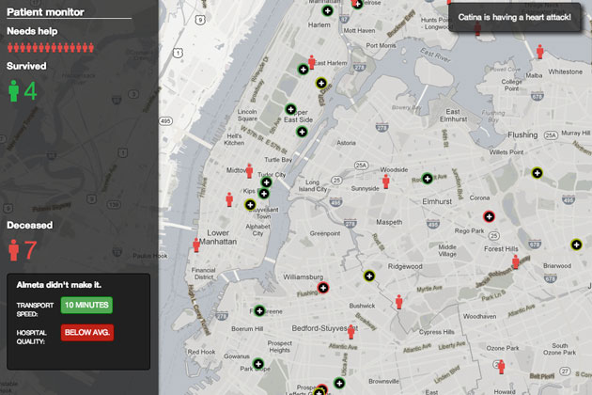
And more worries…
What if they all did agree?
  Death spiral for the bad?
  Ordinarily good in markets, but…

Slide 9
Campbell’s and Goodhart’s Laws
The more any quantitative social indicator (or even some qualitative indicator) is used for social decision-making,
  the more subject it will be to corruption pressures
  and the more apt it will be to distort and corrupt the social processes it is intended to monitor.
Manheim and Garrabrant, Categorizing Variants of Goodhart's Law, https://arxiv.org/abs/1803.04585
  “When a measure becomes a target, it ceases to be a good measure.”
Notes:
http://en.wikipedia.org/wiki/Social_indicator

Slide 10
Something to consider as ratings expand in health care…
Raters Rated | Patients or their agents | 2. Doctors | 3. Hospitals | 4. Insurers
Patients | 1.A. YouTube comments on plastic surgery | 2.A. Medical Justice Database | 3.A. FICO adherence or compliance score | 4.A Intelliscript and databases on risk
B. Doctors | 1.B. Angie’s List Yelp/Consumer Reviews | 2.B. Physician peer review (HCQIA) | 3.C. ACO dashboards | 4.B. NY AG Settlement
C. Hospitals | 1.C. Consumer Reports/Hospital Compare | 2.C. Discussion forums | 3.C. Comparative ads | 4.C. Tiering and cost-sharing
D. Insurers | 1.D Insurance exchanges | 2.D. Payer reviews | 3.D. Rankings of “worst payers” | 4.D Medicare views on Medicare advantage Reinsurance

Slide 11
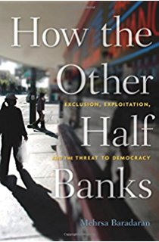

Finance example:
Is this loan coded a “success” by proprietary algos?
Joe takes out a 35% APR loan from a lender.
Desperate to repay it, he does not buy food for his children for a few days, and falls behind on rent.
The lender is paid back in full and makes a profit.

Slide 12

Is this a Fair Deal?
Vina cannot access credit because of a “thin credit file.”
A new fintech firm gives her a chance to obtain credit on good terms, if she allows it to download/analyze all information on her mobile phone during the term of the loan, and re-sell the data.
Vina gets a car loan and makes repayments on time.
She does not know what is done with her data, and cannot find out due to trade secrecy.
Notes:
The contents of a person’s smartphone, including who and when you call and receive messages, what apps are on the device, location data, and more.”
https://privacyinternational.org/node/1499?PageSpeed=noscript (Aug. 30, 2017). See also Josh Chin & Gillian Wong, China’s New Tool for Social Control: A Credit Rating for Everything, Wall St. J., Nov. 28, 2016, at https://www.wsj.com/articles/chinas-new-tool-for-social-control-acredit-rating-for-everything-1480351590; Ian Bogos

Slide 13


Are these appropriate tools of evaluation?
“If lenders see political activity on someone’s Twitter account in India, they’ll consider repayment more difficult & not lend to that individual.”
“[One firm] analyses the way you fill in a form (in addition to what you say in the form), and how you use a website, on what kind of device, and in what location.”
Parkinson’s prediction via mouse tremors.
Notes:
https://privacyinternational.org/node/1499?PageSpeed=noscript (Aug. 30, 2017). See also Josh Chin & Gillian Wong, China’s New Tool for Social Control: A Credit Rating for Everything, Wall St. J., Nov. 28, 2016, at https://www.wsj.com/articles/chinas-new-tool-for-social-control-acredit-rating-for-everything-1480351590; Ian Bogos

Slide 14

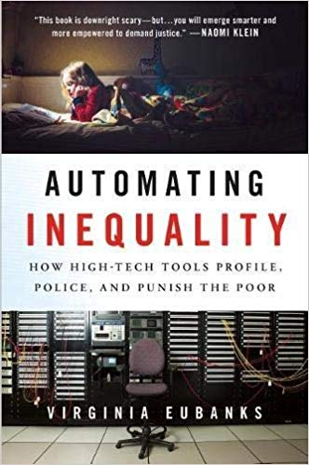
Data and Bias
Accuratism frames answer to bias as “more data”
But critical social science questions that narrative.

Slide 15
Troubling Versions of Financial Inclusion
Predatory Inclusion
Credit enables, debt constrains
Keeanga-Yamahtta Taylor
Seamster & Charron-Chenier
Creepy Inclusion
Creepiness boils down to an intuition of future threat
Subordinating Inclusion
Condition of inclusion is to engage in activity that maintains or entrenches one’s subordinate status
Notes:
Predatory Inclusion and Education Debt: Rethinking the Racial Wealth Gap

Slide 16
Matching Problems and Solutions
Predatory
Creepy
Subordinating
Usury law
Better outcome coding
Data limits
Non-alienability and erasure requirements
Credit cannot be based on certain action/inaction

Slide 17
Rival narratives of credit scoring
Fair allocation of credit according to risk
Redemption of “deadbeats” via opportunities to “rebuild” credit score.
Subordination of the disadvantaged rationalized via algorithm
Machine for generating stigmatic harms that enable profit (higher interest rates).

Slide 18
Formal evaluative criteria cannot accommodate rival narratives
Formalizing projects tend to be
  Driven toward maximizing or satisficing a metric
  Rule based
AI may need “algorithmic realism” the way law needed “legal realism”
  Green B, Viljoen S. Algorithmic Realism: Expanding the Boundaries of Algorithmic Thought. Proceedings of the ACM Conference on Fairness, Accountability, and Transparency (FAT*). 2020
Recognition of the “shadow side” of technology requires:
  Rethinking metrics
  Rethinking data collection
  Discretion to break or change rules
    Who in relevant teams has authority to do this?
    What is their background, their ideology, and their goals?

Slide 19
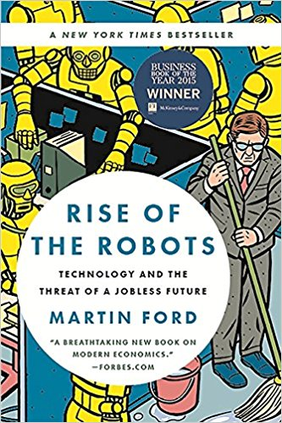

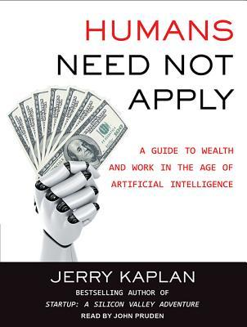

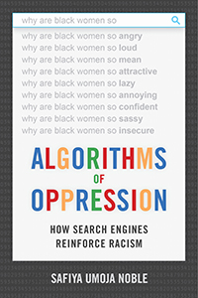
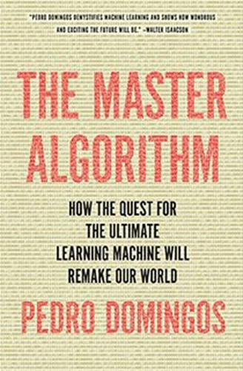
A Larger AI Debate

Slide 20
From AI to IA
Responsible AI development is a critical social aim.
  Toward a Fourth Law of Robotics, Ohio St. L. J. (2018)
Contemporary AI development is data-intensive. Several overlapping legal regimes govern data collection, analysis, and use.
  Grand Bargains for Big Data, Maryland L. Rev. (2013).
Inaccurate and inappropriate data can have massive adverse impacts.
  The Black Box Society (Harvard U.P., 2015).
In many critical areas of human evaluation, our goal should be less AI than “IA:” intelligence augmentation for responsible humans.

